Slide 1
New Home Sales Up 90%
Introduction
New Home Sales Up 90%
HomeBuilder
Solutions
Outro

Slide 2
New Home Sales Up 90%
Introduction
New Home Sales Up 90%
HomeBuilder
Solutions
Outro

Slide 3
New Home Sales Up 90%
Introduction
New Home Sales Up 90%
HomeBuilder
Solutions
Outro

Slide 4
New Home Sales Up 90%
Introduction
New Home Sales Up 90%
HomeBuilder
Solutions
Outro

Slide 5
HomeBuilder
Introduction
New Home Sales Up 90%
HomeBuilder
Solutions
Outro

Slide 6
Introduction
Latest Property Prices
Housing Affordability
Government to the Rescue
FOMO is Driving Up Property Prices
Solutions
Outro

Slide 7
Solutions
Introduction
New Home Sales Up 90%
HomeBuilder
Solutions
Outro

Slide 8
Solutions
Nothing is for free.
Introduction
New Home Sales Up 90%
HomeBuilder
Solutions
Outro

Slide 9
Outro
Introduction
New Home Sales Up 90%
HomeBuilder
Solutions
Outro

Slide 10
Outro
References are in the pinned comments.
Look out for spam bot accounts using my name.
Introduction
New Home Sales Up 90%
HomeBuilder
Solutions
Outro

Slide 11
Rider Levett Bucknall Crane Index
Notes:
https://s31756.pcdn.co/oceania/wp-content/uploads/sites/1/2021/04/RLB-AUS-Crane-Index_Q1_2021.pdf

Slide 13
Dead Weight Loss Due to the Minimum wage

Slide 14
Growing Wealth Disparity
Introduction
Current Asking Prices
Has Housing Peaked
Government to the Rescue
Solutions
Outro
Notes:
https://www.aph.gov.au/About_Parliament/Parliamentary_Departments/Parliamentary_Library/pubs/BriefingBook46p/Inequality

Slide 15
Introduction
Latest Property Prices
Housing Affordability
Government to the Rescue
FOMO is Driving Up Property Prices
Solutions
Outro

Slide 16
Companies Entering External Administration

Slide 19
Australian PCI and ABS building industry output March 2021
Notes:
March 2021
Updated Monthly
https://www.aigroup.com.au/

Slide 20
Generations of the Western World

Slide 23
Most Millennials are Home Owners

Slide 24
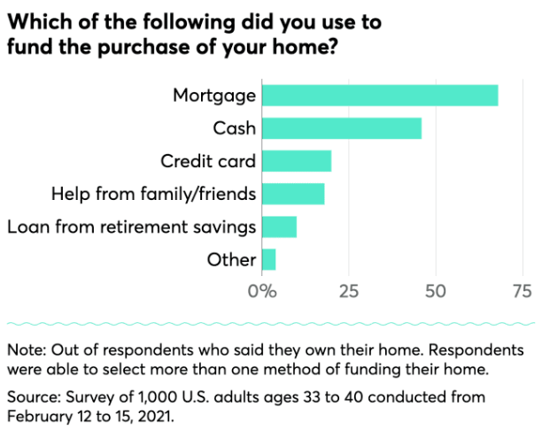

Slide 27
RBA will not raise Rates to slow the housing boom
Reserve Bank governor Philip Lowe warns on house price boom
By business reporters Michael Janda and Gareth Hutchens
Posted WedWednesday 10 MarMarch 2021 at 8:02am, updated WedWednesday 10 MarMarch 2021 at 10:36am
Notes:
https://www.abc.net.au/news/2021-03-10/reserve-bank-warns-on-house-price-boom/13232954

Slide 28
Equity and Corporate Bonds Indicate an Optimistic Outlook
Introduction
Global Risks
Australian Households
Australian Businesses
Australian Financial System
Domestic Regulator Developments
Solutions
Outro

Slide 29
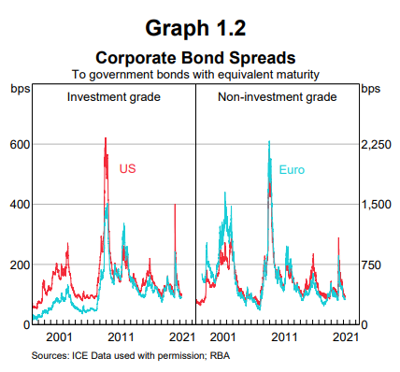
Investment Funds can Amplify Asset Price Declines
Introduction
Global Risks
Australian Households
Australian Businesses
Australian Financial System
Domestic Regulator Developments
Solutions
Outro

Slide 30
Housing Price Growth
Introduction
Global Risks
Australian Households
Australian Businesses
Australian Financial System
Domestic Regulator Developments
Solutions
Outro

Slide 31
Risks Elevation for Small Business
Introduction
Global Risks
Australian Households
Australian Businesses
Australian Financial System
Domestic Regulator Developments
Solutions
Outro

Slide 32
Banks have been Resilient
Introduction
Global Risks
Australian Households
Australian Businesses
Australian Financial System
Domestic Regulator Developments
Solutions
Outro

Slide 33
Financial stability Risks in China Remain Elevated
Introduction
Global Risks
Australian Households
Australian Businesses
Australian Financial System
Domestic Regulator Developments
Solutions
Outro

Slide 34
Emerging Market Economies
Introduction
Global Risks
Australian Households
Australian Businesses
Australian Financial System
Domestic Regulator Developments
Solutions
Outro

Slide 35
Ongoing Challenges
Introduction
Global Risks
Australian Households
Australian Businesses
Australian Financial System
Domestic Regulator Developments
Solutions
Outro

Slide 36
Introduction
Global Risks
Australian Households
Australian Businesses
Australian Financial System
Domestic Regulator Developments
Solutions
Outro

Slide 37
Introduction
Global Risks
Australian Households
Australian Businesses
Australian Financial System
Domestic Regulator Developments
Solutions
Outro

Slide 38
Introduction
Global Risks
Australian Households
Australian Businesses
Australian Financial System
Domestic Regulator Developments
Solutions
Outro

Slide 39
Profitability
Introduction
Global Risks
Australian Households
Australian Businesses
Australian Financial System
Domestic Regulator Developments
Solutions
Outro

Slide 40
Business Insolvencies
Introduction
Global Risks
Australian Households
Australian Businesses
Australian Financial System
Domestic Regulator Developments
Solutions
Outro

Slide 41
Commercial Property Risks
Introduction
Global Risks
Australian Households
Australian Businesses
Australian Financial System
Domestic Regulator Developments
Solutions
Outro

Slide 42
Office and Industrial Properties
Introduction
Global Risks
Australian Households
Australian Businesses
Australian Financial System
Domestic Regulator Developments
Solutions
Outro

Slide 43
Introduction
Global Risks
Australian Households
Australian Businesses
Australian Financial System
Domestic Regulator Developments
Solutions
Outro

Slide 44
Introduction
Global Risks
Australian Households
Australian Businesses
Australian Financial System
Domestic Regulator Developments
Solutions
Outro

Slide 45
Non-Performing Loans
Introduction
Global Risks
Australian Households
Australian Businesses
Australian Financial System
Domestic Regulator Developments
Solutions
Outro

Slide 46
Non-Bank Financial Institutions
Introduction
Global Risks
Australian Households
Australian Businesses
Australian Financial System
Domestic Regulator Developments
Solutions
Outro

Slide 47
K- Shaped Recovery

Slide 48
K- Shaped Recovery

Slide 49
K- Shaped Recovery
Notes:
https://www.investopedia.com/k-shaped-recovery-5080086

Slide 50
What would Aussies Buy?
Notes:
https://www.youtube.com/channel/UCe9Q_WLN-Z9tLVLoDIY24pg/community?lb=Ugwg8rsUlh5FSswt1WB4AaABCQ

Slide 51
Average Weekly Earnings 1990 to 2020
Notes:
https://www.ausstats.abs.gov.au/ausstats/free.nsf/0/8558853E59121639CA257E9100173DBD/$File/63500%20Average%20weekly%20earnings%201941-1990.pdf

Slide 52
First Home Buyer Affordability
Introduction
The Hot Housing market
Latest Housing Data
Government to the Rescue
The RBA Won’t Stop the Housing boom
Solutions
Outtro
Notes:
Lorenz Curve

Slide 53
Up 565% in 30 Years

Slide 54
Housing Prices Around the World

Slide 55
Domain House Price report
Introduction
The Hot Housing market
Latest Housing Data
Government to the Rescue
The RBA Won’t Stop the Housing boom
Solutions
Outtro
Notes:
https://www.domain.com.au/research/house-price-report/

Slide 56
Domain Unit Price report
Introduction
The Hot Housing market
Latest Housing Data
Government to the Rescue
The RBA Won’t Stop the Housing boom
Solutions
Outtro
Notes:
https://www.domain.com.au/research/house-price-report/

Slide 57
% of Weekly Earnings to pay a mortgage
Updated 09/04/2021

Slide 58
% of Weekly Earnings to pay a mortgage (Couple)

Slide 59
Declining Economic Complexity
Introduction
Landlords Selling to Avoid New Laws
Latest Weekly Rent
Government to the Rescue
Rent Controls
Solutions
Outtro

Slide 61
Australian Energy Market
Notes:
https://anero.id/energy

Slide 62
Embodied Energy Definition
Notes:
https://www.yourhome.gov.au/materials/embodied-energy

Slide 63
Embodied Energy Example

Slide 64
Wind Turbine Embodied Energy
Notes:
Life-cycle energy analysis of wind turbines – an assessment of the effect of size on energy yield
https://www.witpress.com/Secure/elibrary/papers/ESUS07/ESUS07016FU1.pdf
https://msd.unimelb.edu.au/about/our-people/academic/robert-crawford

Slide 65
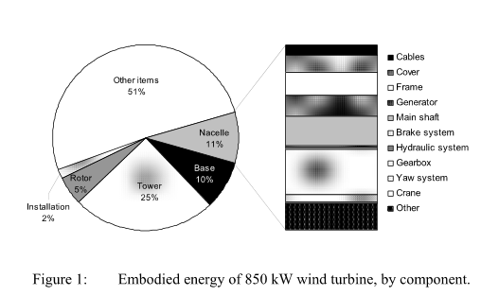

Slide 69
End of Life

Slide 70
Government to the Rescue
Government intervention is stimulating the market

Slide 71
Keeping Zombie Companies Alive
Trading While Insolvent Provisions External administrations are at half of the average. (5000 Insolvencies Expected)​
JobKeeper Nearly 9% of the Victorian Workforce were supported by Jobkeeper

Slide 72
Jobkeeper Applicants (Oct 2020)

Slide 73
Percentage of Employed People

Slide 74
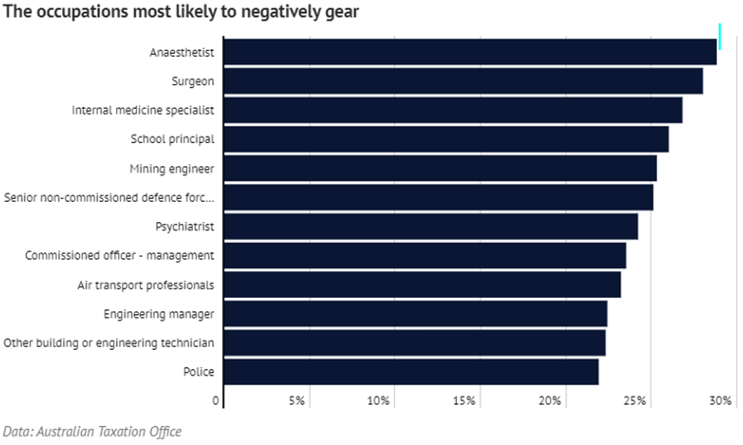
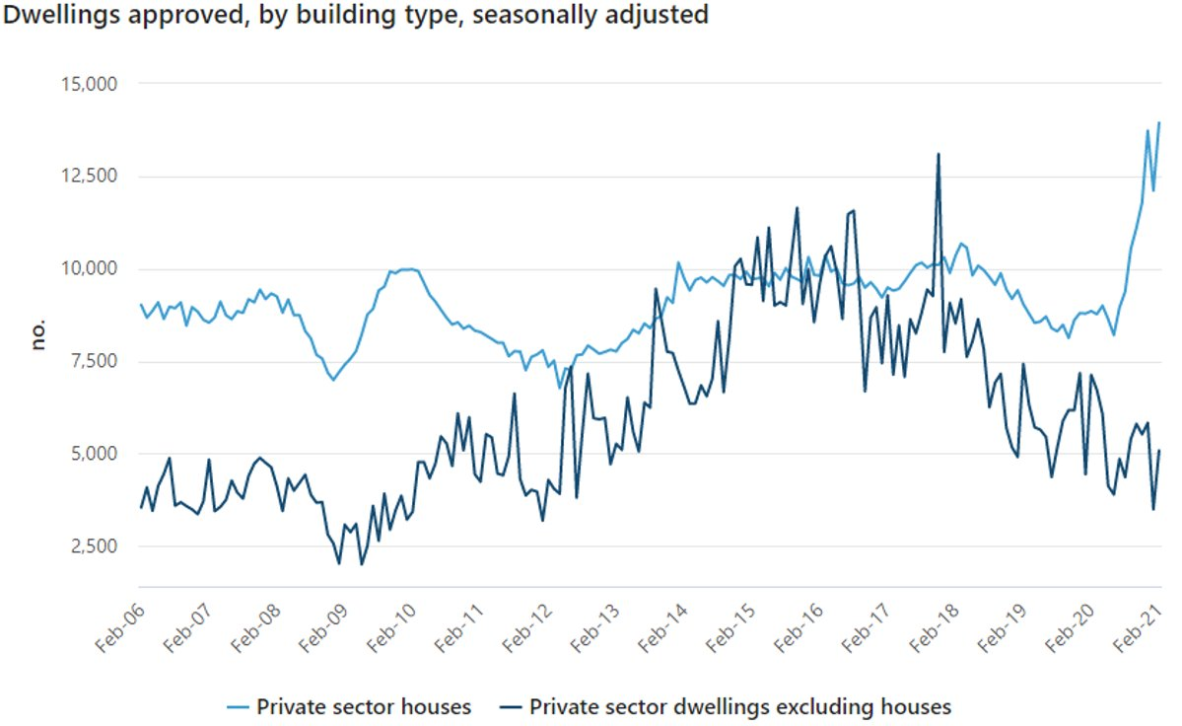
Juicing ​the ​Market​
RBA Cash Rate Crash ​
(3% Used to be considered the emergency level) ​
HomeBuilder​
First Home Buyer Grants (Up to $88,000 when you combine state and federal grants)​
5% Government Loan Guarantee​
Negative Gearing​
Super Withdrawals

Slide 75
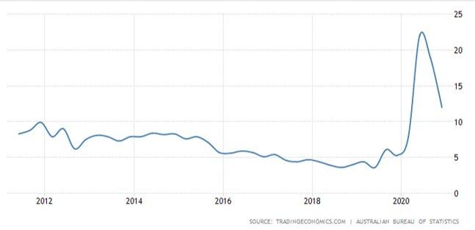
Reducing Housing Supply
Councils Limiting Developments
Mortgage Holidays ​
Uncertainty (Savings Rate Surges)

Slide 76
Private Rental Affordability
Notes:
https://www.agriculture.gov.au/abares/data/agricultural-census-visualisations#production-area-number-and-yield

Slide 77
Rent Controls

Slide 78
Rent Controls
Notes:
https://www.tutor2u.net/economics/blog/unit-1-micro-revision-on-maximum-rents-in-housing

Slide 79
Rent Controls

Slide 81
Introduction
What is M0, M1, M2 & M3 Money Supply.
Inflation Over Time
Hyper Inflation
Is the FED Hiding Hyper Inflation?
Why would the FED hide Inflation?
The FED’s Argument
Solutions
Outro

Slide 82
Introduction
What is M0, M1, M2 & M3 Money Supply.
Inflation Over Time
Hyper Inflation
Is the FED Hiding Hyper Inflation?
Why would the FED hide Inflation?
The FED’s Argument
Solutions
Outro

Slide 83
Opportunity Cost
Introduction
Renewables before food
Embodied Energy
Current Wind Generation
Wind Turbine Embodied Energy
Solutions
Outtro
Notes:
https://www.investopedia.com/terms/o/opportunitycost.asp

Slide 84
Introduction
What is M0, M1, M2 & M3 Money Supply.
Inflation Over Time
Hyper Inflation
Is the FED Hiding Hyper Inflation?
Why would the FED hide Inflation?
The FED’s Argument
Solutions
Outro

Slide 85
Introduction
What is M0, M1, M2 & M3 Money Supply.
Inflation Over Time
Hyper Inflation
Is the FED Hiding Hyper Inflation?
Why would the FED hide Inflation?
The FED’s Argument
Solutions
Outro
Notes:
https://www.investopedia.com/terms/m/m1.asp#:~:text=M1%20is%20a%20narrow%20measure,as%20savings%20accounts%20and%20bonds.

Slide 86
Introduction
What is M0, M1, M2 & M3 Money Supply.
Inflation Over Time
Hyper Inflation
Is the FED Hiding Hyper Inflation?
Why would the FED hide Inflation?
The FED’s Argument
Solutions
Outro

Slide 87
Introduction
What is M0, M1, M2 & M3 Money Supply.
Inflation Over Time
Hyper Inflation
Is the FED Hiding Hyper Inflation?
Why would the FED hide Inflation?
The FED’s Argument
Solutions
Outro

Slide 88
Inflation Over Time
Introduction
What is M0, M1, M2 & M3 Money Supply.
Inflation Over Time
Hyper Inflation
Is the FED Hiding Hyper Inflation?
Why would the FED hide Inflation?
The FED’s Argument
Solutions
Outro

Slide 89
A Dictionary of the English Language, published in 1755
Introduction
What is M0, M1, M2 & M3 Money Supply.
Inflation Over Time
Hyper Inflation
Is the FED Hiding Hyper Inflation?
Why would the FED hide Inflation?
The FED’s Argument
Solutions
Outro
"The state of being swelled with wind; flatulence."

Slide 90
Webster’ American Dictionary of the English Language, published by G&C Merriam Co. in 1864
Introduction
What is M0, M1, M2 & M3 Money Supply.
Inflation Over Time
Hyper Inflation
Is the FED Hiding Hyper Inflation?
Why would the FED hide Inflation?
The FED’s Argument
Solutions
Outro
"undue expansion or increase, from over-issue; — said of currency."

Slide 91
Century Dictionary published from 1889 to 1891
Introduction
What is M0, M1, M2 & M3 Money Supply.
Inflation Over Time
Hyper Inflation
Is the FED Hiding Hyper Inflation?
Why would the FED hide Inflation?
The FED’s Argument
Solutions
Outro
"Undue expansion of elevation; increase beyond the proper or just amount of value: as, inflation of trade, currency, or prices; inflation of stocks (that is, the price of stocks)."

Slide 92
A Dictionary of American English on Historical Principles 1938 to 1944
Introduction
What is M0, M1, M2 & M3 Money Supply.
Inflation Over Time
Hyper Inflation
Is the FED Hiding Hyper Inflation?
Why would the FED hide Inflation?
The FED’s Argument
Solutions
Outro
"of money and prices: overexpansion"

Slide 93
Latest Weekly Rental Costs
Introduction
Landlords Selling to Avoid New Laws
Latest Weekly Rent
Government to the Rescue
Rent Controls
Solutions
Outtro
SQM Research

Slide 94
Melbourne Rents are Falling
Introduction
Landlords Selling to Avoid New Laws
Latest Weekly Rent
Government to the Rescue
Rent Controls
Solutions
Outtro

Slide 95
Weekly Melbourne Rent Listings – SQM
Introduction
Landlords Selling to Avoid New Laws
Latest Weekly Rent
Government to the Rescue
Rent Controls
Solutions
Outtro

Slide 96
Melbourne Houses Vs Units
Introduction
Landlords Selling to Avoid New Laws
Latest Weekly Rent
Government to the Rescue
Rent Controls
Solutions
Outtro

Slide 97
Weekly Rent Index
Introduction
Landlords Selling to Avoid New Laws
Latest Weekly Rent
Government to the Rescue
Rent Controls
Solutions
Outtro

Slide 98
Weekly Rent Index
Introduction
Landlords Selling to Avoid New Laws
Latest Weekly Rent
Government to the Rescue
Rent Controls
Solutions
Outtro

Slide 99
Introduction
Landlords Selling to Avoid New Laws
Latest Weekly Rent
Government to the Rescue
Rent Controls
Solutions
Outtro

Slide 100
First Home Buyers Lead the market

Slide 101
Sydney Property Listings
Notes:
https://sqmresearch.com.au/total-property-listings.php?region=act%3A%3ACanberra&type=c&t=1&hu=1

Slide 102
Sydney House & Unit Listings

Slide 103
Melbourne Property Listings

Slide 104
Melbourne House & Unit Listings

Slide 105
Brisbane Property Listings

Slide 106
Brisbane House & Unit Listings

Slide 107
Canberra Property Listings

Slide 108
Canberra House & Unit Listings

Slide 109
Darwin Property Listings

Slide 110
Darwin House & Unit Listings

Slide 111
Adelaide Property Listings

Slide 112
Adelaide House & Unit Listings

Slide 113
Hobart Property Listings

Slide 114
Hobart House & Unit Listings

Slide 115
Perth Property Listings

Slide 116
Perth House & Unit Listings

Slide 117
National Office Vacancy Rates
Notes:
https://research.propertycouncil.com.au/data-room/office

Slide 118
Canberra Office Vacancy Rates
Notes:
https://research.propertycouncil.com.au/data-room/office

Slide 119
What would Aussies Buy?
Notes:
https://www.youtube.com/channel/UCe9Q_WLN-Z9tLVLoDIY24pg/community?lb=Ugwg8rsUlh5FSswt1WB4AaABCQ

Slide 120
Capital City Average Asking Prices

Slide 121
National Asking Prices

Slide 122
Sydney Asking Prices

Slide 123
Melbourne Asking Prices

Slide 124
Brisbane Asking Prices

Slide 125
Property Asking Prices Cairns

Slide 126
Total Property Listing on Cairns

Slide 127
Cairns Weekly Rental Listings

Slide 128
Cairns Residential Vacancy Rates

Slide 129
Cairns Weekly Rents

Slide 130
National net Debt of $1.298 Trillion in 2023-24.

Slide 131
Solitions
Long term we need to reduce our dependence on property.
Introduction
Current Property Listing
Government to the rescue
Housing Supply Crashes
What would Aussies Buy?
Solutions
Outro

Slide 132
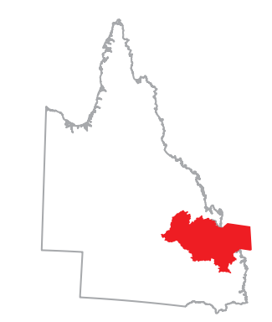
Solutions
Long term we need to reduce our dependence on property.
Create Special Economic Regions to experiment with reduced levels of government intervention into the economy.
Introduction
Current Property Listing
Government to the rescue
Housing Supply Crashes
What would Aussies Buy?
Solutions
Outro

Slide 133
Solutions
Watch the Hidden Secrets of Money by Mike Maloney
Invest in Gold?
Invest in Silver? (The Silver Squeeze)
Investing in Crypto? (CBDCs)
Invest in Property?
Investing in Real Physical Assets?
Never Bet Against the FED or Sue the FED?
Will the US economy Boom? Jamie Dimon “Goldilocks Moment”
Introduction
What is M0, M1, M2 & M3 Money Supply.
Inflation Over Time
Hyper Inflation
Is the FED Hiding Hyper Inflation?
Why would the FED hide Inflation?
The FED’s Argument
Solutions
Outro
Notes:
https://www.asgoodasgoldaus.com.au/hidden-secrets-of-money/

Slide 134
Australia needs Freedom of Speech
Advocate for a real Australian Bill of Rights that enshrines Freedom of Speech.
Without the provisions to make it meaningless.
Repeal “Hate Speech Laws”
Introduction
100 Points of ID for Facebook or Tinder
Government to the Rescue
Previous Enquiry
Solutions
Outtro

Slide 135
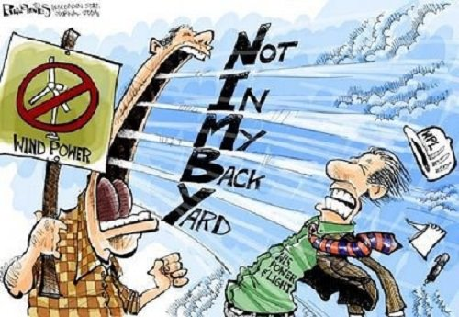
Solutions
Advocate for Local and State Governments to increase the supply of homes.
Don’t vote for parties who limit development and construction.
Fight the NIMBY crowd. (Greenies and Hipsters)
Introduction
The Hot Housing market
Latest Housing Data
Latest Weekly Rent
Government to the Rescue
Solutions
Outtro

Slide 136
Solutions
Acknowledge that the Andrews Government is driving up houses.
Advocate for Local and State Governments to increase the supply of homes.
Don’t vote for parties who limit development and construction.
Fight the NIMBY crowd. (Greenies and Hipsters)

Slide 137
Solutions
Always be Skeptical.

Slide 138
Become Politically Active
Contact your local member of council and ask what they have been doing to reduce the cost of housing?
EG: Advocate for reduced Headworks charges.
Contact your state member and ask them what they have been doing to reduce red tape at a state level to reduce the cost of housing?
Contact your federal member
Contact Minor Party Senators or prospective candidates and let them know that they would get your support if they publicly advocated for reduced government intervention into housing.
Use Social Media to make the conversation public.

Slide 139
Increase Financial Literacy
Increase general Financial Literacy.
Encourage Freedom from Debt to promote individuality.
Promote wider understanding of Austrian Economics.
Introduction
The Hot Housing market
Latest Housing Data
Government to the Rescue
The RBA Won’t Stop the Housing boom
Solutions
Outtro

Slide 140
Outro
References are in the pinned comments.
Look out for spam bot accounts using my name.

